Slide 1




prepPad
spring 2025
software development: group 05
Project Checkup
presented by:
Cristian Mejia Davey Renoid Benita Chinemerem Olatunde Mojisola

Slide 2
Requirement gathering
Presentation Outline
01
Background
02
Team
03
Technology & Tradeoffs
04
Early Results & Problems
05
Approach to Evaluation
06
Design & Prototype
07
Plans for completion
08
Summary
02

Slide 3
Background
75%
~$30
The percentage of resumes are rejected by ATS before reaching a human recruiter, due to formatting, content, or lack of keywords.
The cost for monthly subscriptions on traditional platforms like LinkedIn Learning, Simplify Premium or paid resume-review services.
Source: Scoop
03

Slide 4

Project Overview
prepPad
prepPad is a job-matching & tracking platform designed specifically for students, prioritizing affordability and insights. It offers core functionality at low cost by leveraging open source tools and machine learning models.
04

Slide 5




Team Members
Cristian Mejia
Davey Renoid
Benita Chinemerem
Olatunde Mojisola
Backend & Database
Frontend & UX Design
DevOps & QA
Product Management & UX Design
05

Slide 6

Personas
Current Pain Points
I’ve applied to 50 internships, but I'm not getting any responses back after weeks.
I spend weeks manually comparing my resume to job postings, which is time-consuming and frustrating.
I struggle to find affordable resources to help me bridge the gaps in my skills and qualifications.
How does prepPad help me?
I visit the site and begin the account creation process. I sign up using my email and password.
After creating my account, I click the "Upload Resume" button. The application parses my resume and saves the individual sections (e.g., experience, education, skills) for easy editing.
I find a job posting I’m interested in and upload the link to the application. The application parses the job posting and analyzes the key details (e.g., degree level, skills required, etc.)
The application compares my resume data with the job posting and provides a match rating based on how well my profile aligns with the job requirements.
If I don’t meet all the qualifications, the application generates a personalized learning plan that outlines the steps I need to take to gain competency.
Outcome
I no longer waste time manually comparing and tailoring my resume to job postings.
I receive actionable feedback and a clear roadmap to improve my qualifications.
I feel confident that my resume is a fit for each job application.
Angela
Age:21 Gender: Female Interests: Product Design, Software Development
Need: Internship, entry level employment
06

Slide 7
Technology Choices and Tradeoffs
Frontend
NextJS (React) implementation
TailwindCSS for styling
Responsive UI design for various screens
User interface for all key features (signup, login, resume upload, profile)
Backend
Django (Python) implementation
API endpoints for frontend communication
Utilizes Deepseek V3 and NER (bert-base-NER) for parsing and analysis of documents
Database
PostgreSQL (via Supabase)
Prisma ORM integration
Schema design for users, resumes, job postings, and matching data
Infrastructure
Repository structure and organization
Project management tracking system
Communication channels (Google Docs, Discord)
07
Notes:
NextJS - an open-source React-based web development framework
TailwindCSS - an open-source CSS framework focused on ease-of-use
Django - an open-source Python-based web framework which enables rapid deployment and prototyping
Supabase - Backend-as-a-Service (BaaS) platform which is built upon PostgreSQL database and offers built-in user authentication
PrismaORM - an open-source service to create and query our PostgreSQL database w/o using raw SQL, integrates directly with Supabase

Slide 8
Technology Choices and Tradeoffs
User Authentication
Implementing JWT-based authentication which provides security but adds more work compared to using third-party auth providers (NextAuth or Auth0).
Adding SSO/social logins in future would require an authentication overhaul.
Resume Processing
For prototyping purposes, using Deepseek V3 for parsing and analyzing resumes
Further development includes training models to extract keywords in resume according to job description
Job Posting Processing
Due to restrictions against web scraping job posting sites, our fallback method is uploading the link to the job posting
Extracts details from the posting such as the role description, qualifications & skills required, role responsibilities, location, etc.
Resume-Job Analysis
Using techniques such as Named Entity Recognition (NER) to extract key entities from files (e.g. skills, qualifications, etc.) to perform matching
Fine-tuning of models needed to improve classification
API Integration
Utilizing Django REST framework to simplify API development
Integrate Supabase auto-generated REST APIs into backend
Learning Plan Generator
Working to implement this with aggregated data from resume and job analysis to guide users to free resources (e.g. roadmap.sh) and certifications (e.g. AWS Cloud Certifications)
08
Notes:
NextAuth.js is a complete open-source authentication solution for Next.js applications. It is designed from the ground up to support Next.js and Serverless.
We removed social media/ single sign on due to time and knowledge gap
Instead of creating full scale authentication, we seeded the user to the application to move forward with the implementation of the endpoint communications (communication with other components)

Slide 9



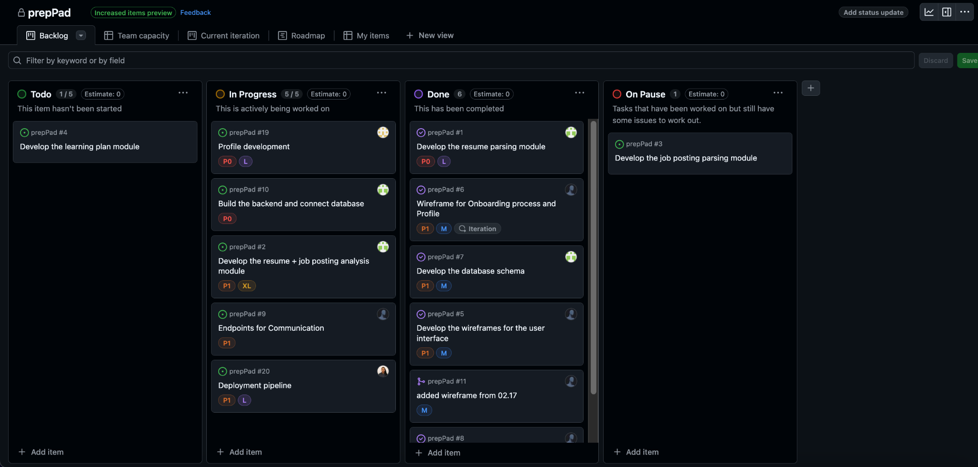
Early Results
09
Project Structure and Management
Set up project management tracking (Github projects and Kanban board)
Established communication channels (Google Doc and Discord)
Frontend Development
Created a responsive UI with the following pages:
Sign up
Log in
Resume upload interface
Manual input for profile creation
UI/UX
Created wireframes
Created user personas
Created high fidelity mockup for entire screens
Created an end-to-end prototype of the entire user flow

Slide 10



Early Results
Backend Development
Developed resume analysis module
Developed job posting analysis module
Created backend application for handling server-side logic
Database Implementation
Established PostgreSQL database (using Supabase)
Set up Prisma ORM
Created database structure where the user information is saved
DevOps
Organized the repository structure
Created a VM on Azure
Created backend and frontend CI/CD
Configured backend and frontend Docker files.
10

Slide 11
Problems
Technical Knowledge Gaps
Knowledge gap in regards to training models for extracting job description parameters from website data
Web Scraping Limitations
Companies use methods to hinder web parsing such as auto generated tags
Specific difficulty in parsing LinkedIn and Handshake links due to user account requirements
Unable to access certain job postings without authenticated accounts on these platforms
Frontend Development Challenges
Issues with implementing certain frontend interactivity features (Blur background)
11

Slide 12
Problems
Devops Challenges:
Read-only access for the Azure student account (preventing the use of some Azure-specific deployment feature.
Knowledge gap in fixing docker build context issue
Created workflows not working across teams
12

Slide 13
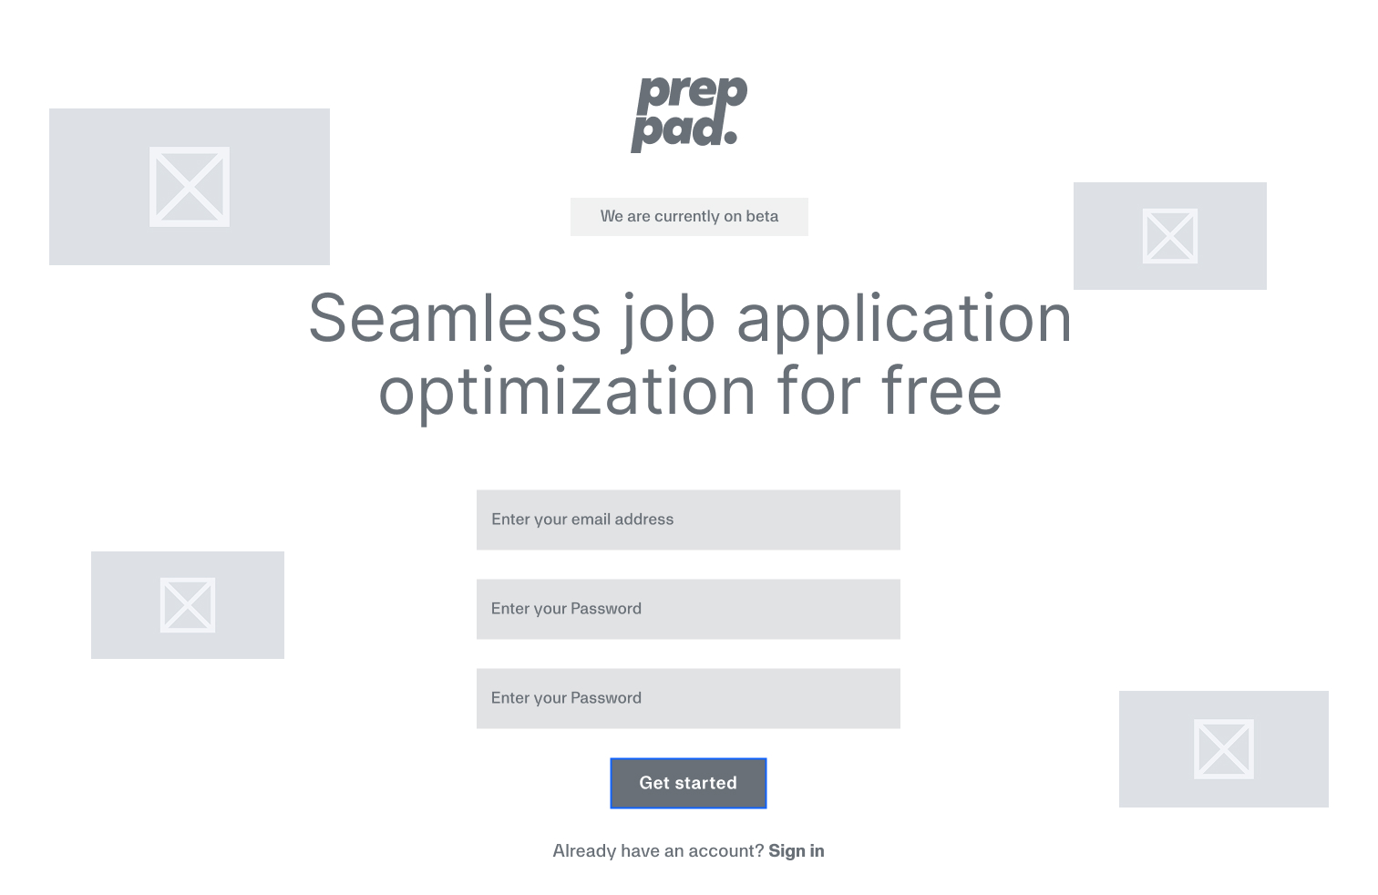
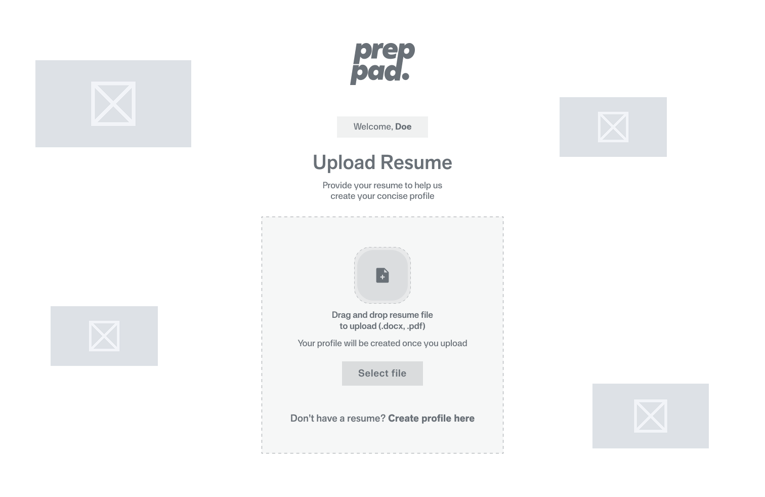
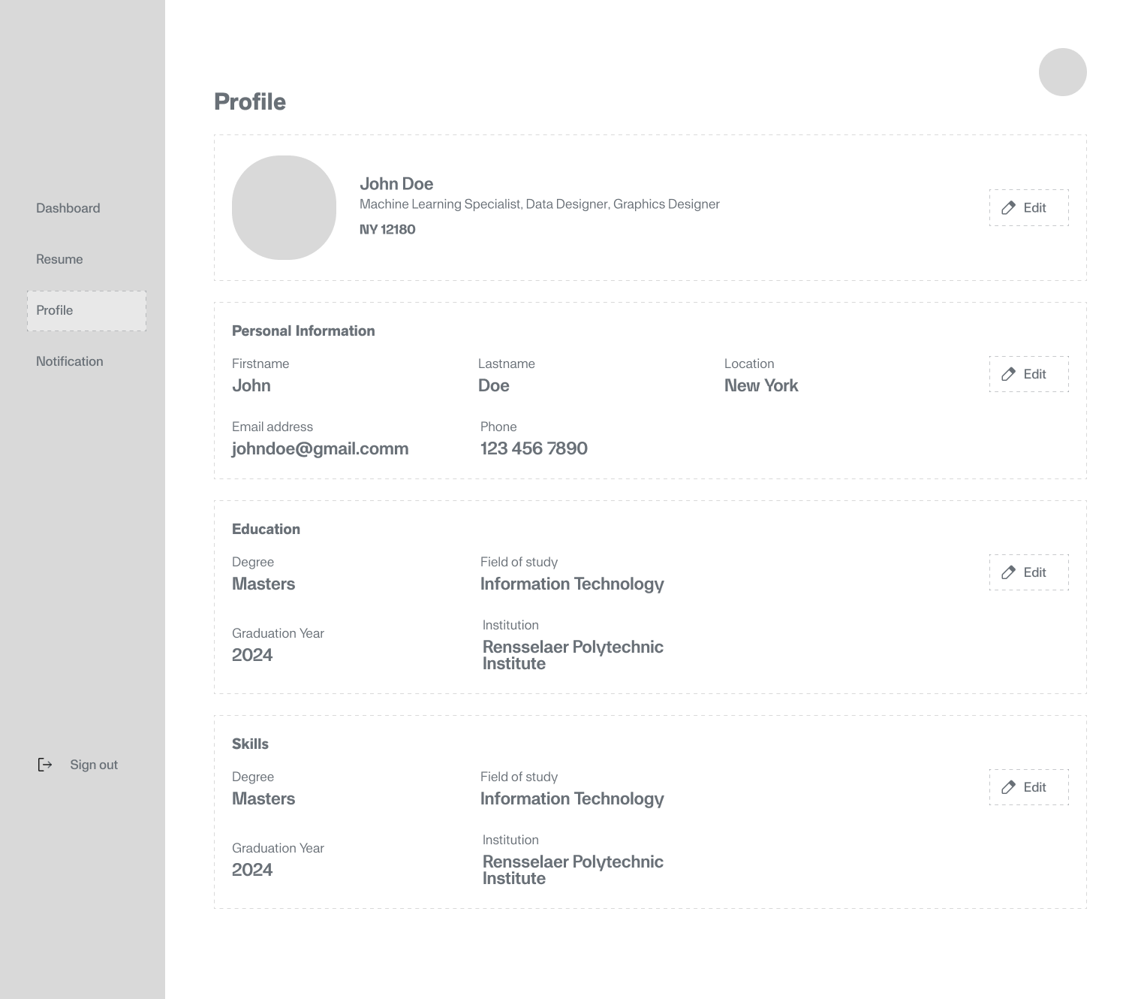
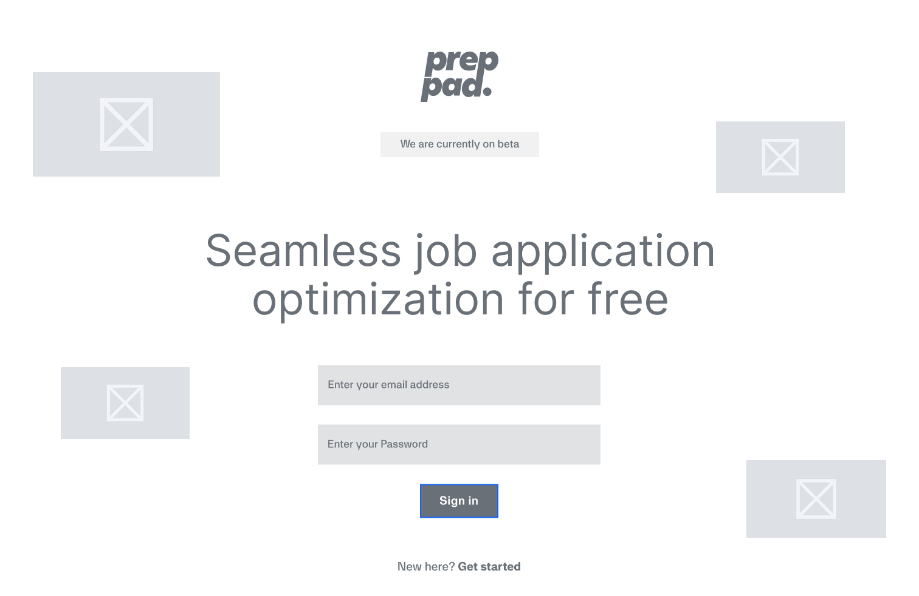
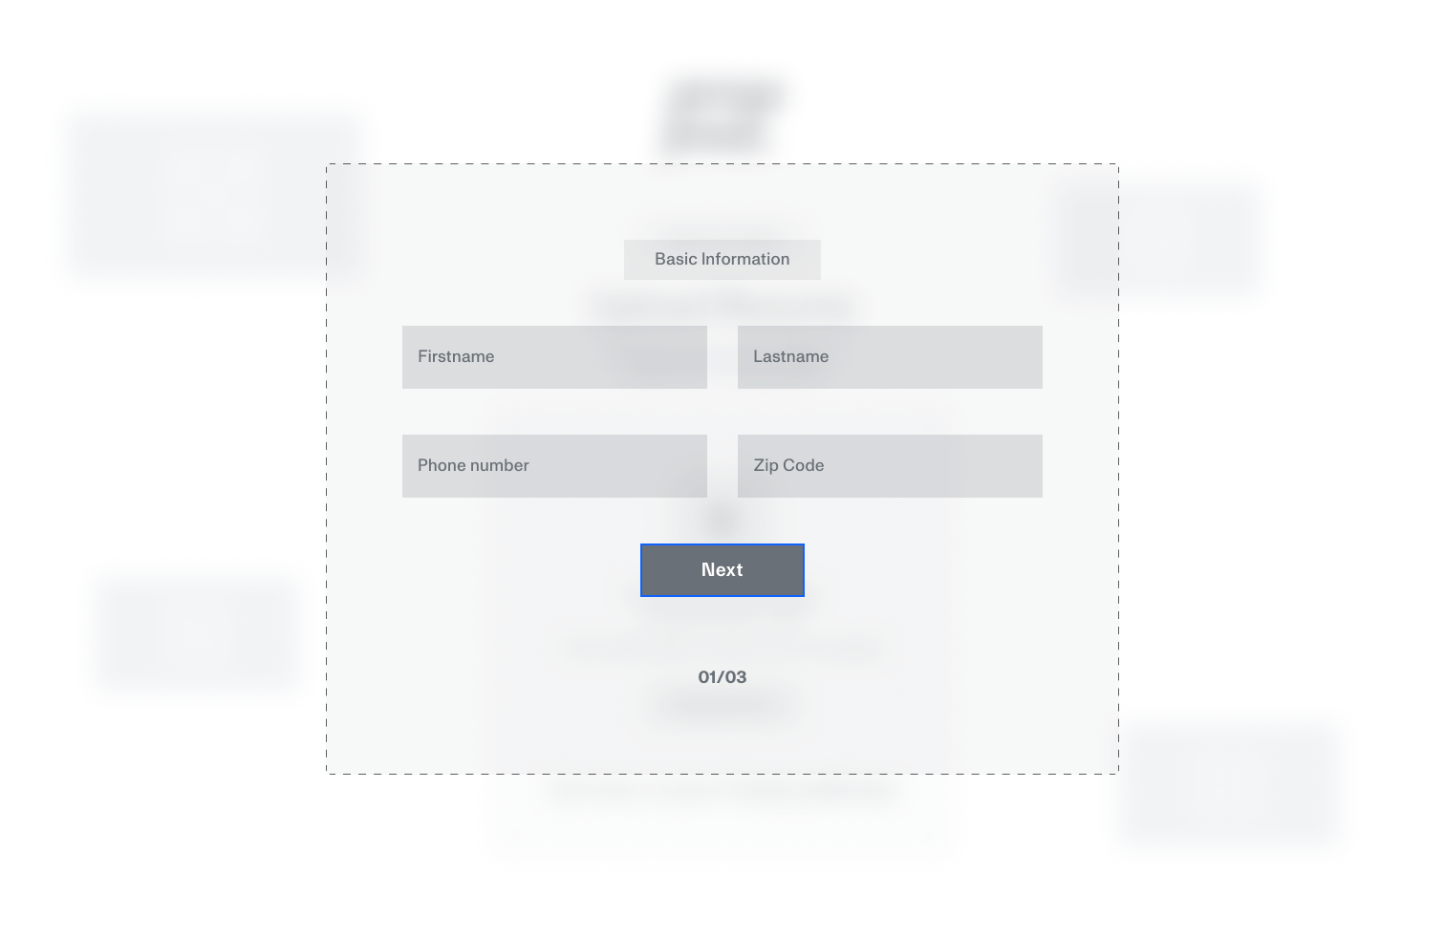
Wireframe
Homepage/Sign Up page
Resume upload page
Profile page
Sign in page
Manual Input page
13

Slide 14
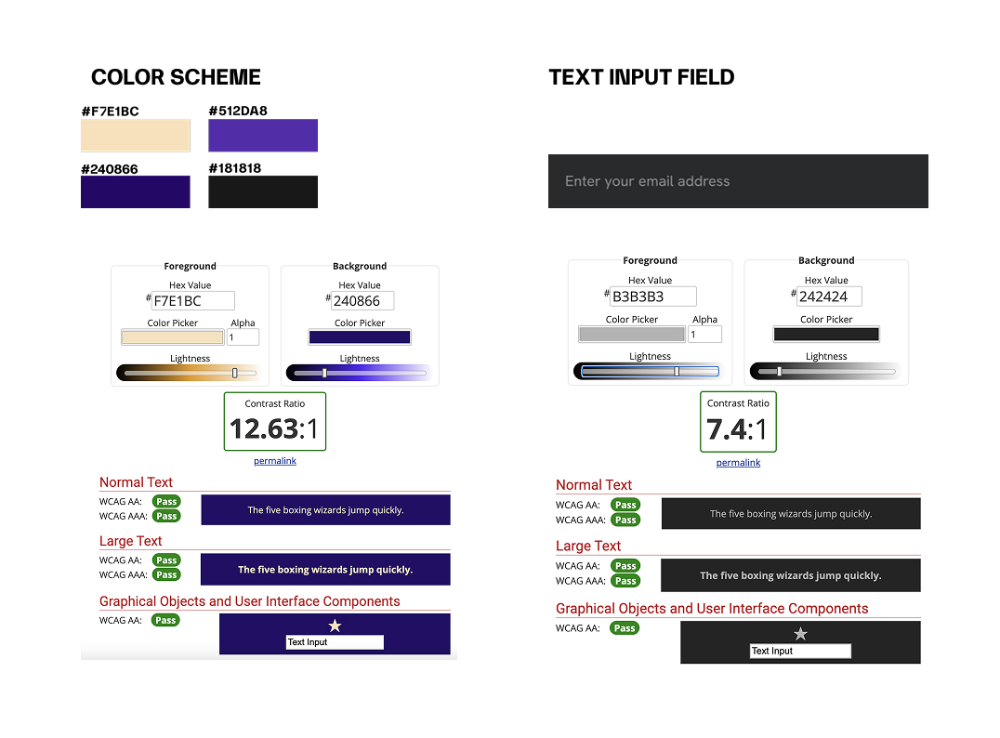
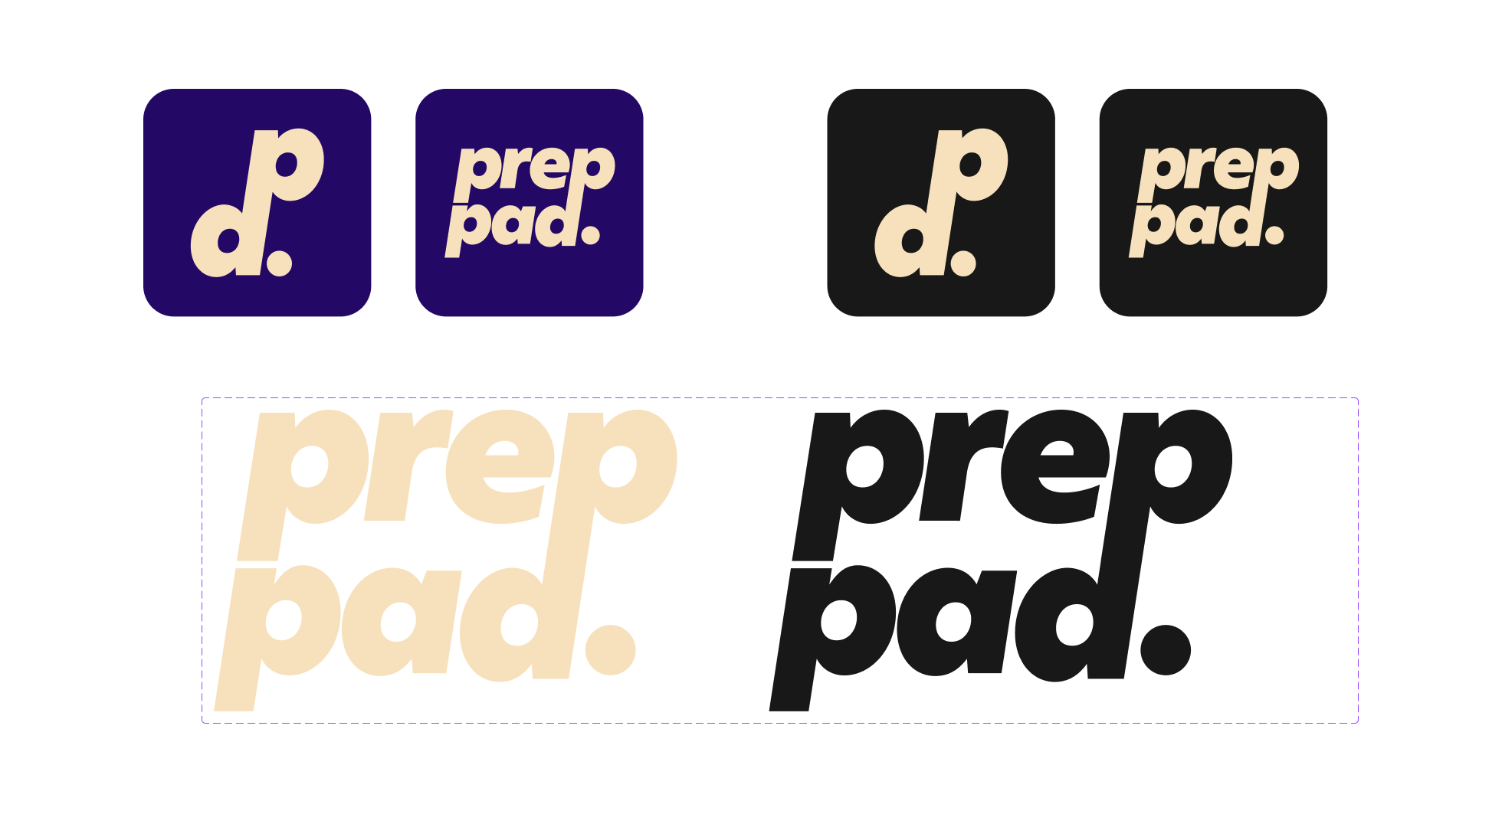
Branding
14
Typeface: Amina

Slide 15
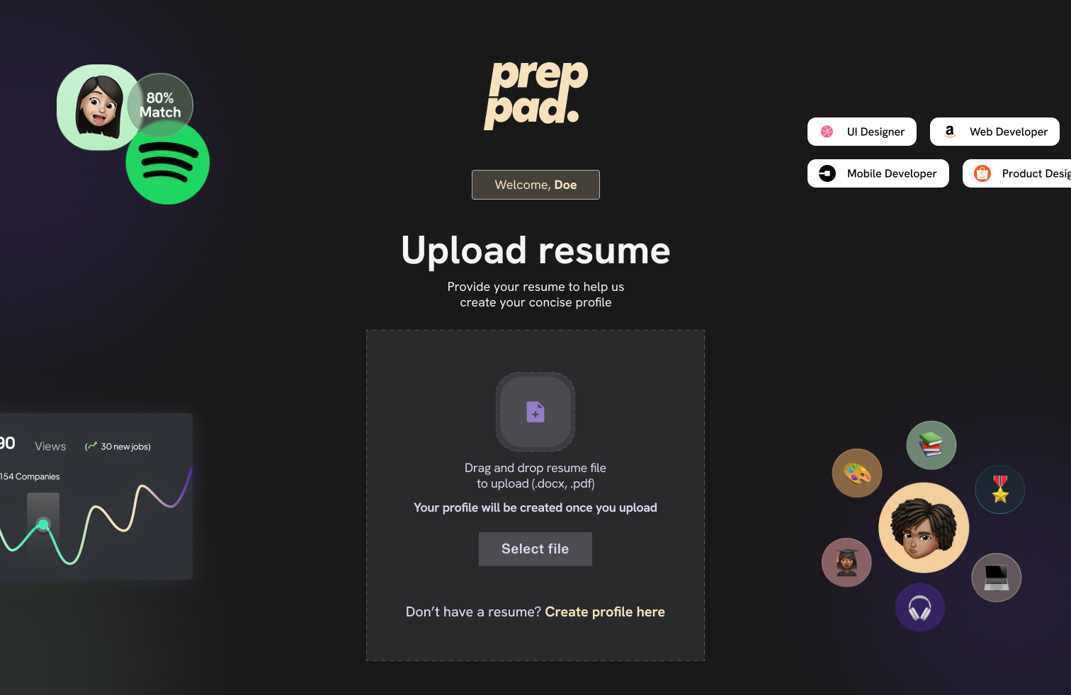
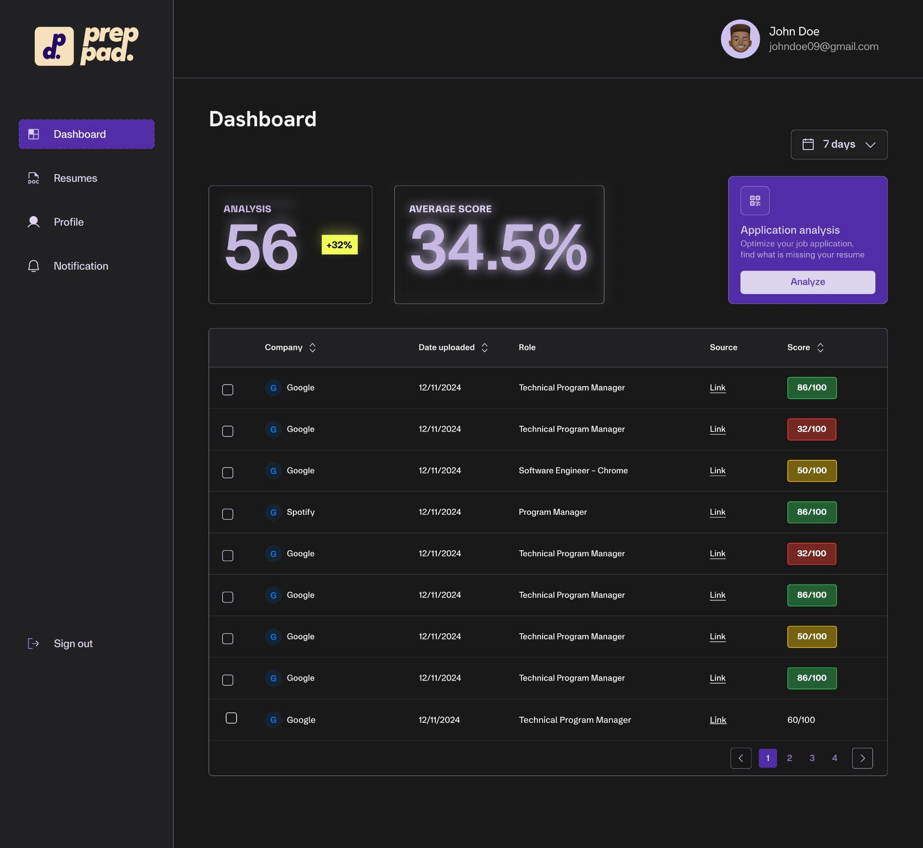
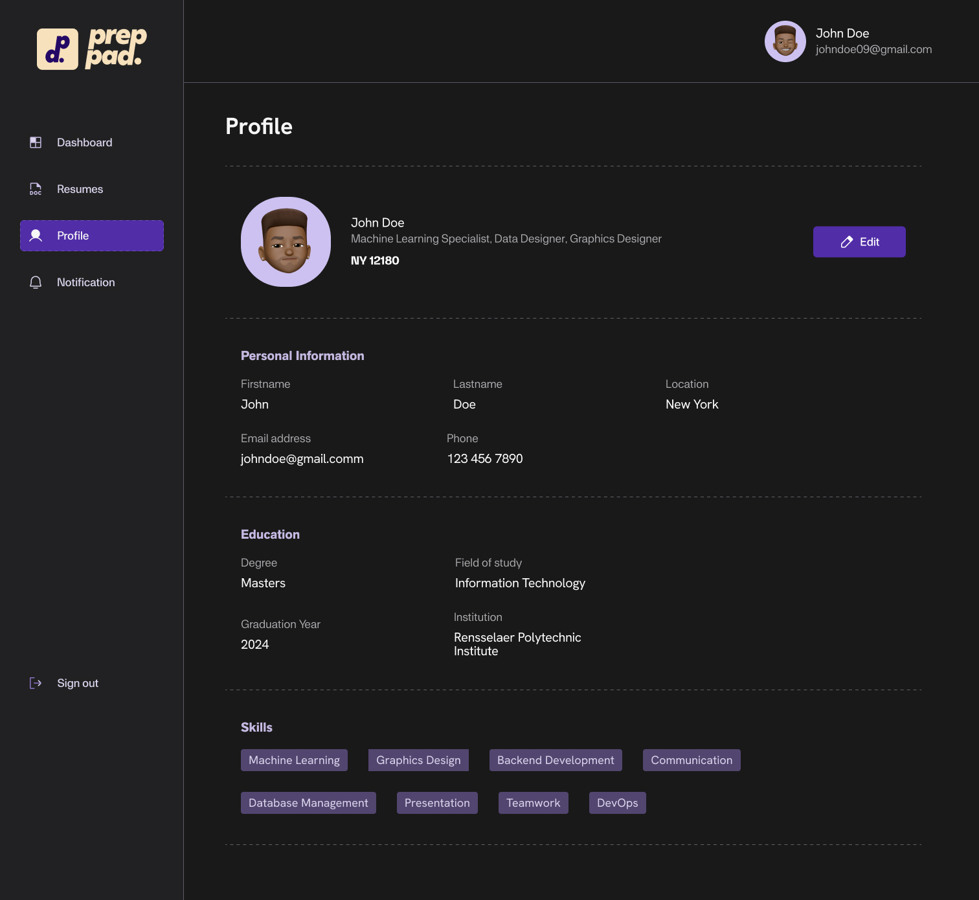
Mock-up
15

Slide 16
Approach to evaluation
Core Functionality
User registration and profile creation
Resume parsing and storage
Job link submission and scraping
Resume to job match comparison and ratings
User Experience Evaluation
Heuristic Analysis: We are designing the user interface against usability principles (e.g. Aesthetic and minimalism, and Recovery from errors etc.)
Task Completion Metrics: We are currently looking at how easy users find the key tasks like resume upload and job matching.
Functionality Testing
Unit Tests: We are testing individual components (Backend & Frontend) in isolation to ensure they perform as expected
Integration Tests: We would be verifying that different parts of the system work together correctly.
End-to-End Testing: We would be validating complete user flows from registration to receiving resume-job match results.
Match Algorithm Validation
Accuracy Testing: We will be comparing the algorithm recommendations against human expert and other top platforms.
Variability Testing: We will ensure there’s consistent results for similar inputs.
16
Notes:
Performance assessment:

Slide 17
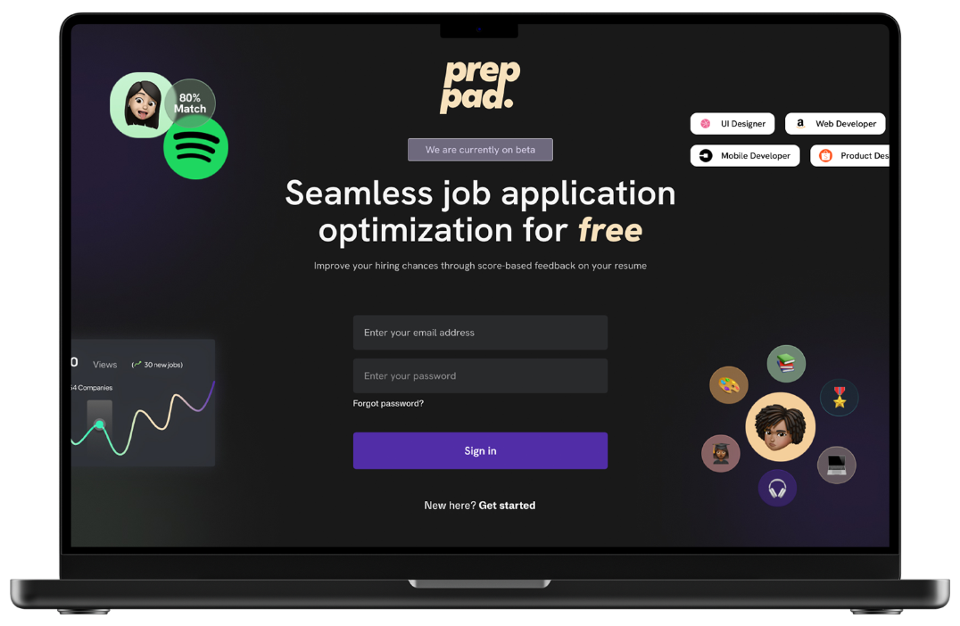
Prototype
Design Prototype
Frontend Prototype
Backend Prototype
17

Slide 18
Plan for completion (Sprint 3: ~2 weeks)
Tasks
User Profile Implementation: Finalize both frontend interface and backend functionality for user profiles, including:
Displaying parsed resume information
Allowing manual edits to extracted data
Saving and retrieving profile information
API Endpoint Integration: Complete the communication pathways between frontend and backend systems, focusing on:
User profile - Resume upload and parsing flow
User profile management
Job posting submission and analysis
Resume - Job Comparison Feature: Develop the core matching algorithm that:
Compares user skills against job requirements
Identifies skill gaps and strengths
Generates match scores with explanations
Dashboard Implementation: Create a central interface showing:
Overview of job analysis
Line item of jobs analyzed
Match scores across different jobs
18

Slide 19
Plan for completion (Sprint 3; ~ 2 weeks)
70%
20%
10%
Frontend efforts
Backend efforts
DevOps efforts
UI | User Profile Management | Sprint 3 (~ 2 weeks)
 | Resume - Job Comparison
 | Dashboard
API | Endpoints for calls | Sprints 3 (~2 weeks)
Testing | Ensure endpoints work | (5 days)
Modules | Learning Plan Generation | Sprint 3 (~ 2 weeks)
Database | Ensure functionality | Sprints 3 (~2 weeks)
Testing | Ensure endpoints work | (5 days)
Environment Setup |  | Sprint 3 (~ 1 week)
Deployment |  | Sprints 3 (~ 1 week)

Slide 20

Conclusion
prepPad aims to simplify the application process by automating resume-job matching and delivering real time skill insights. Its technical architecture, combining NextJS, TypeScript, Tailwind CSS, and Django, enables both rapid development and scalable performance. The platform's skill-matching capabilities deliver immediate value by helping students identify qualification gaps and tailor their applications to specific positions.
20

Slide 21
Thank you
21

